Slide 1
requirements
The main user is admin (cashier)
We need to know when any produt is about to run out
We need to make daily reports to know what is the most bought items and the least bought items to make sales decions

Slide 2

CONTEXT DIAGRAM FOR Restourant
chef
food
Food request
customer data
restaurant
casheir
0
food request
dailyreport
management
food
supplier
itemes order

Slide 3
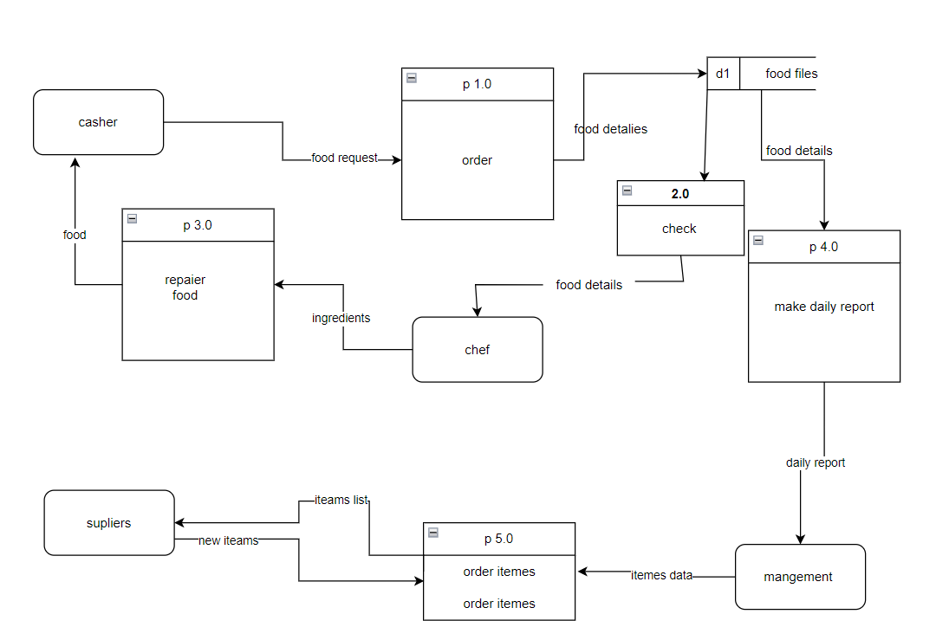
Level 1 :

Slide 4
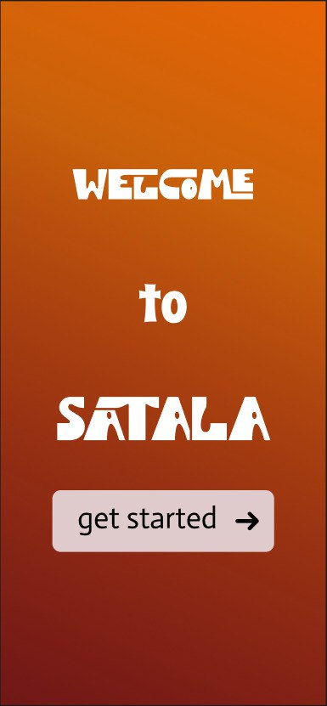

Slide 5
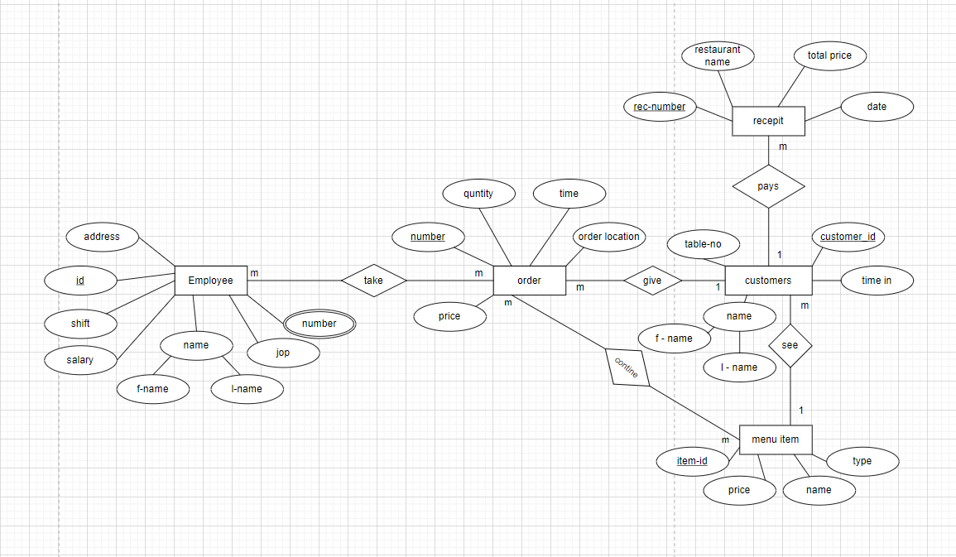
ERD

Slide 6
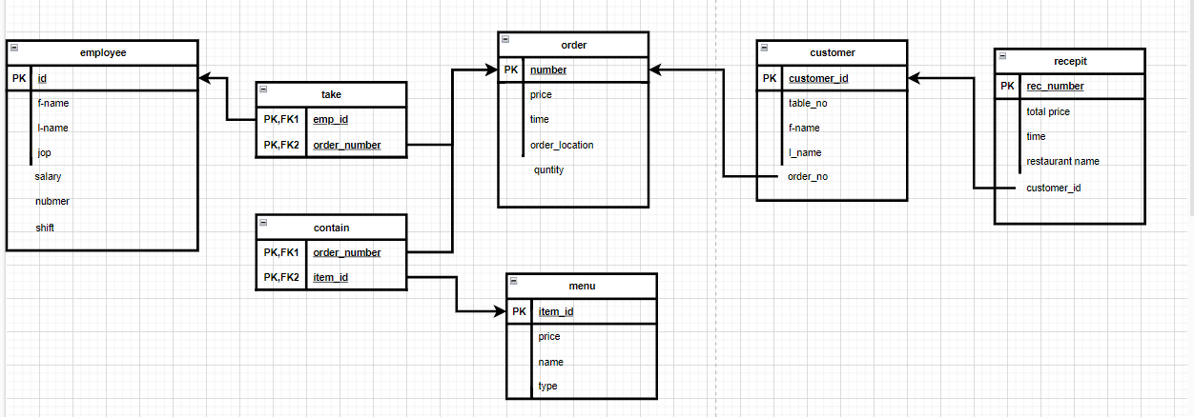
Schema

